Slide 1


Numerical groundwater modelling under changing water abstraction in Weyib watershed, Ethiopia
12th July 2024
Sina Mohammadian
B.Sc in Water Sciences and Engineering @ Ferdowsi University of Mashhad
Mahdi Farmahinifarahani (Arad)
Undergraduate Geology student @ Kharazmi University

Slide 2
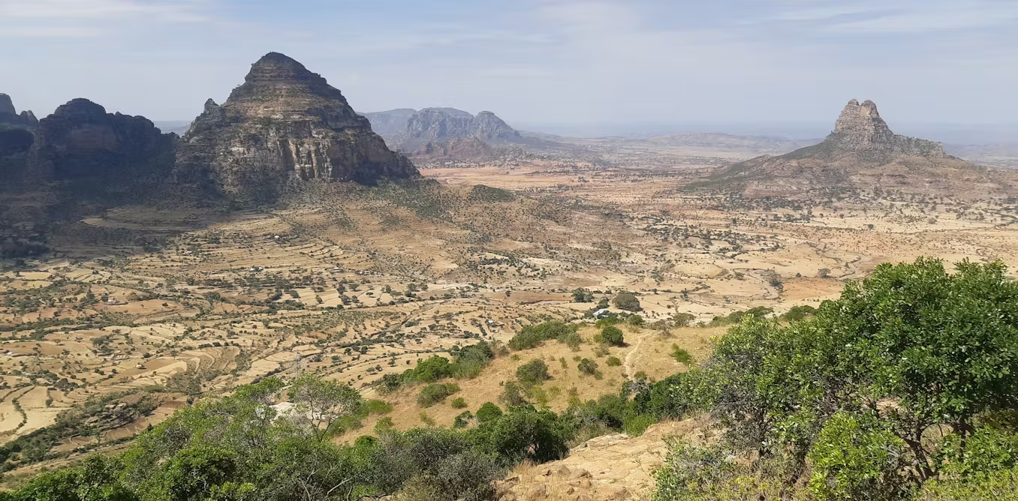
Notes:
Our case study for today's presentation is Ethiopia, which is mostly known for its coffee in the community. We decided to show you a picture of Ethiopian nature for the first slide to give you an idea of ​​where we are going to discuss.

Slide 3
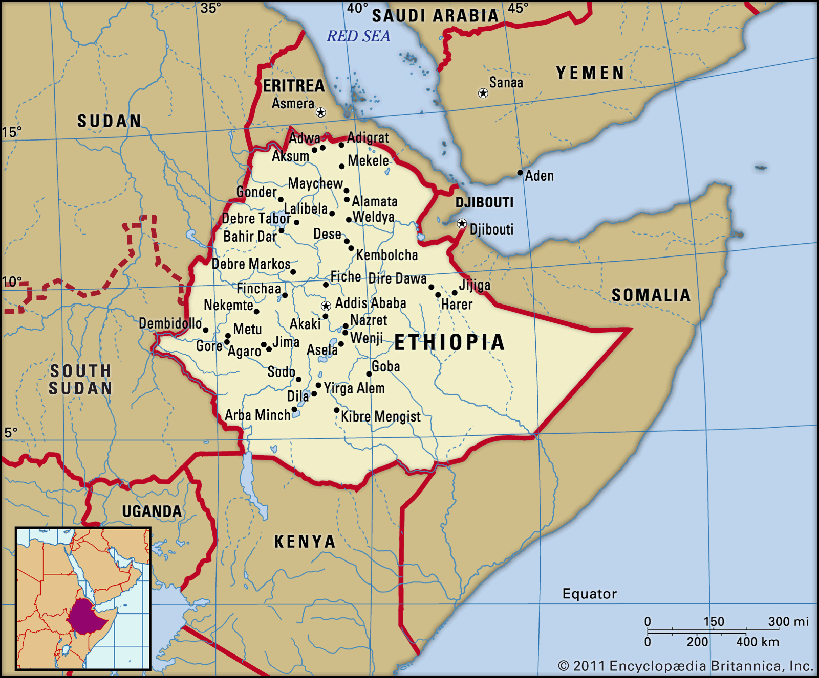
Notes:
Ethiopia, officially the Federal Democratic Republic of Ethiopia, is a landlocked country located in the Horn of Africa region of East Africa. It shares borders with Eritrea to the north, Djibouti to the northeast, Somalia to the East, Kenya to the South, South Sudan to the West, and Sudan to the Northwest.

Slide 4
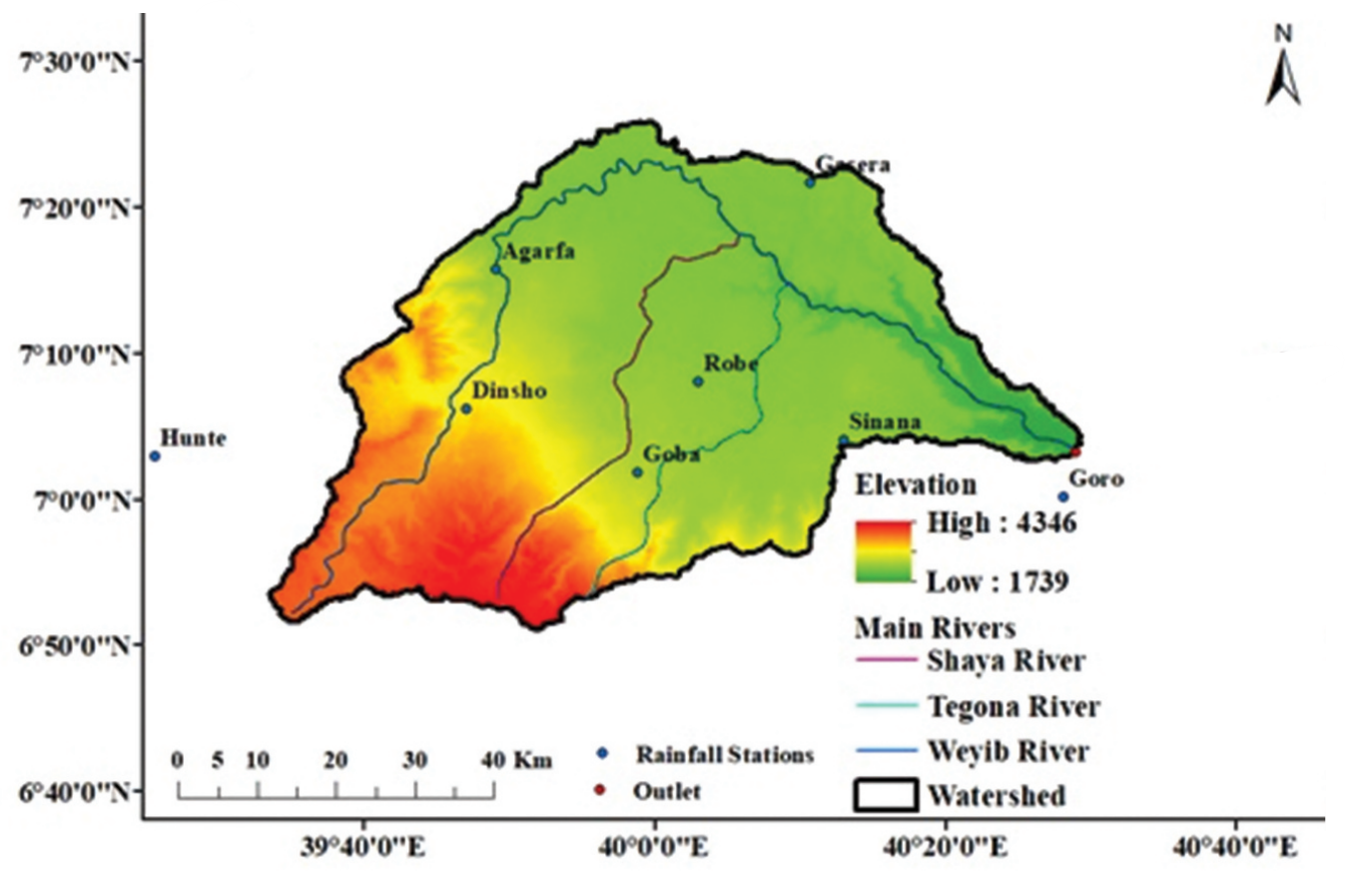
Weyib watershed Digital Elevation Model
Notes:
Weyib River drains roughly 3611 km2 in Ethiopia’s Genale Dawa River Basin lies between 6.83° to 7.46°N latitude and 39.53° to 40.50°E longitude (Figure 1). The topography ranges from 1739 m in the lower reach to 4346 m above mean sea level in the highland of Bale Mountains National Park.

Slide 5
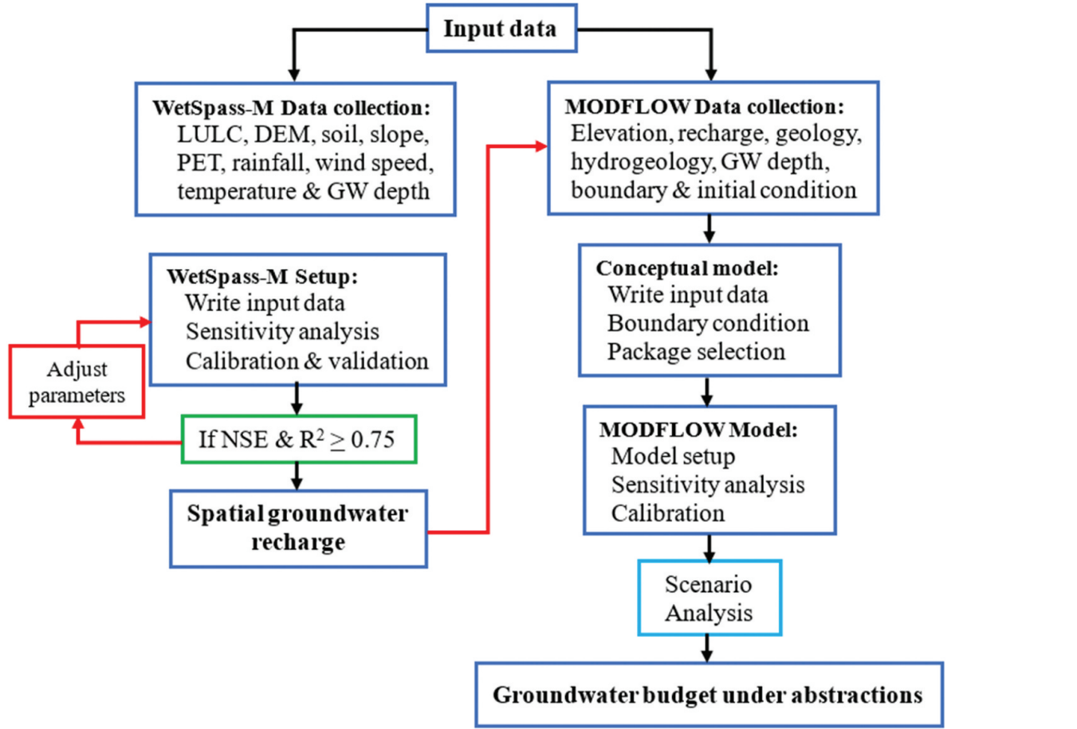
Notes:
Here you can see the conceptual framework of the methodology we will discuss. At first it seams a little bit complicated and maybe you'll be confused

Slide 6

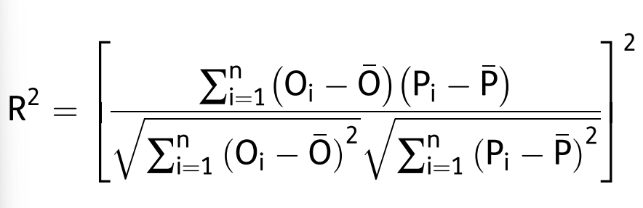
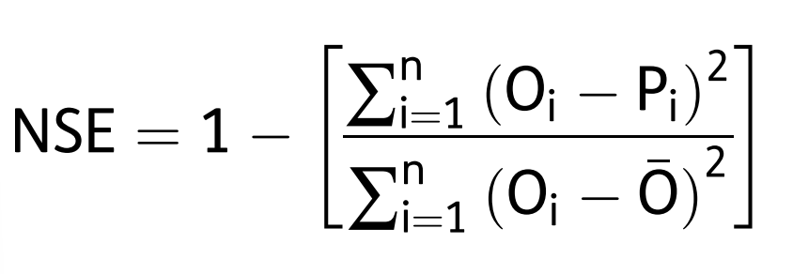
WetSpass-M model
Inputs
Spatial data interpolation
Outputs
soil type, topography, and climate conditions.
IDW
Estimated Groundwater Recharge
IHACRES
Separate river flow into baseflow and runoff
Validation:
Notes:
Where; Oi is the i th observed value, Pi is the i th model-simulated value, Ois the mean of observed data, Pis the mean of the model-simulated value and n is the number of observations.
coefficient of determination (R2 ) and Nash-Sutcliff Efficiency (NSE). The values of NSE range from -∞ to 1; the higher the value the better agreement

Slide 7
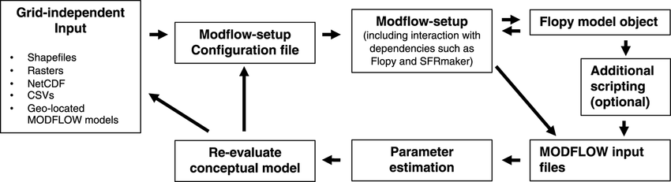
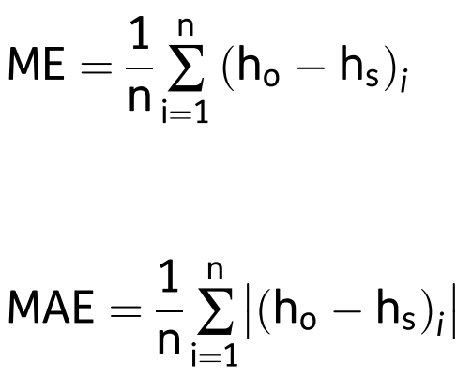
MODFLOW-2005
MODFLOW uses the finite differences method to solve the groundwater flow equation. The grid is created using structured, rectilinear (rectangular) grids.
Validation:
The MODFLOW-2005 model was calibrated with the help of 53 boreholes in this study so that it could have the best results.

Slide 8
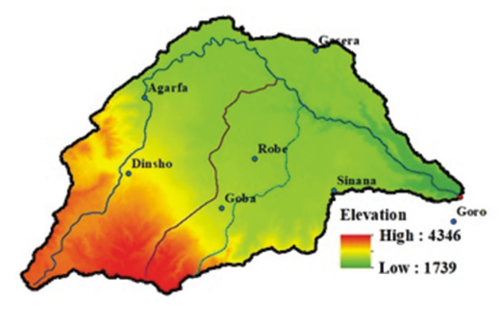
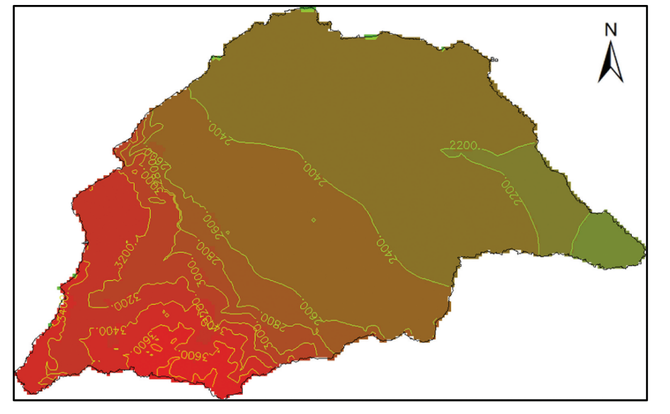
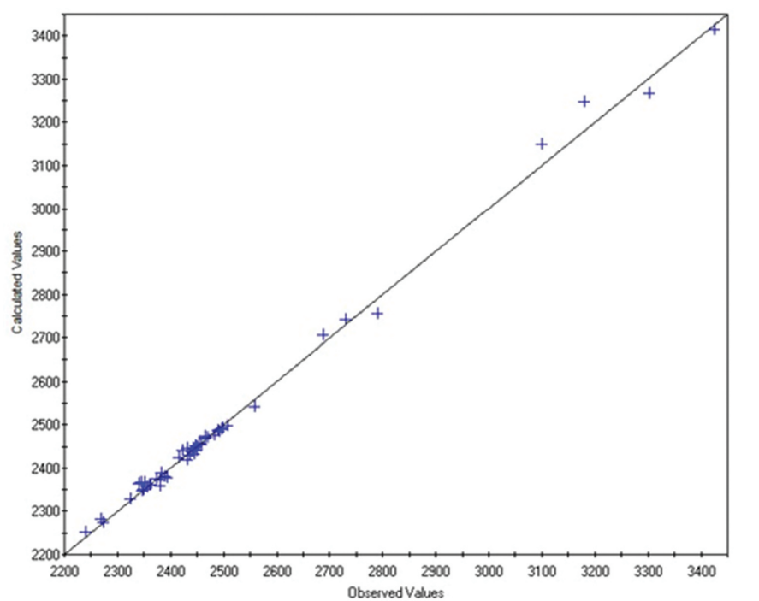
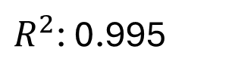
The annual groundwater recharge ranges from zero to 560 mm with a mean value of 177.66 mm/year
Model Calibration
$R^{2}$: 0.995

Slide 9
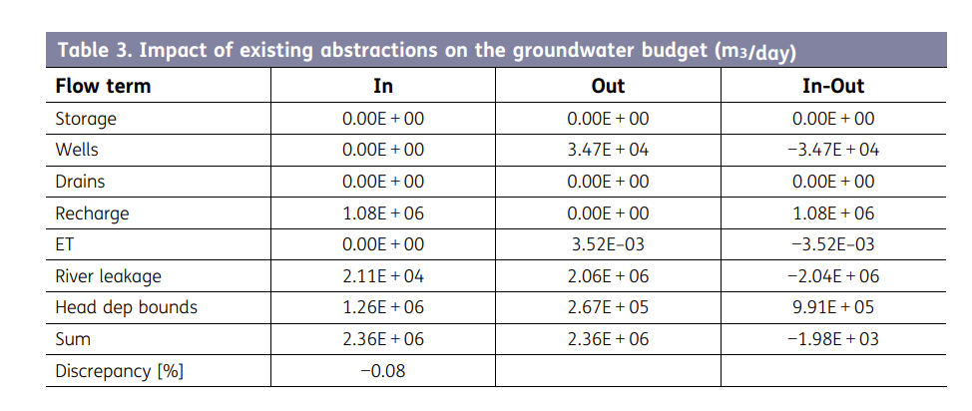
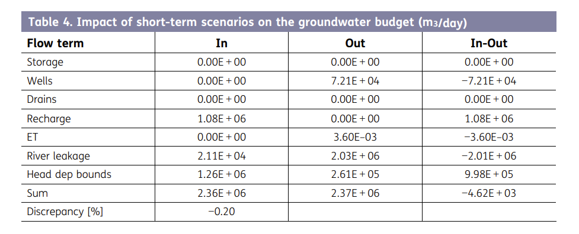
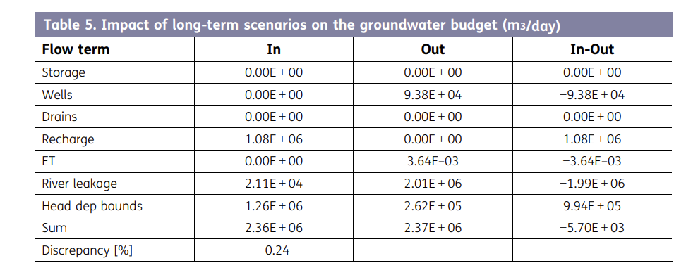
Notes:
The groundwater budgets were simulated under changing existing abstractions, short-term and longterm water demand scenarios in the Weyib watershed. The existing groundwater abstractions estimated was 34, 686.39 m3/day. Depending on population projections, the estimated short-term and long-term water demand scenarios were 72,113.61 and 93,795.57 m3/day, respectively.
The study assessed the groundwater budget in the Weyib Watershed using WetSpass-M and MODFLOW-2005 models. Annual recharge varied from 0 to 560 mm, averaging 177.66 mm/year. Current water abstraction is 34,686.39 m³/day, with future projections at 72,113.61 and 93,795.57 m³/day. This leads to a deficit in the groundwater budget, with outflows slightly exceeding inflows. The highest recharge rates were in upstream areas, decreasing towards the watershed outlet. Increasing water demand will likely reduce river leakage and outflow, affecting the watershed’s long-term groundwater sustainability.

Slide 10


